Slide 1

ANALYSIS OF WINE QUALITY
DATASET USING MACHINE LEARNING
TEAM-6
E. SONY
A. HIMA VAMSHIKA
M. VARSHA SRI

Slide 2
CONTENT
Introduction& Objective
Data Set
Data Cleaning
EDA
ML Algorithms
Conclusion
Insights
Appendix

Slide 3
INTRODUCTION
Wine is a beverage made of fermented grape and other fruit juices with lower amount of alcohol content.
Quality of wine is graded based on the taste of wine and vintage. This process is time taking, costly and not efficient.
OBJECTIVE
Our main objective is to predict the wine quality using machine learning through python.
A large dataset is considered and wine quality is modelled to analyse the quality of wine through different parameters like fixed acidity, volatile acidity etc.
All these parameters will be analysed through ML classification& regression algorithms.

Slide 4
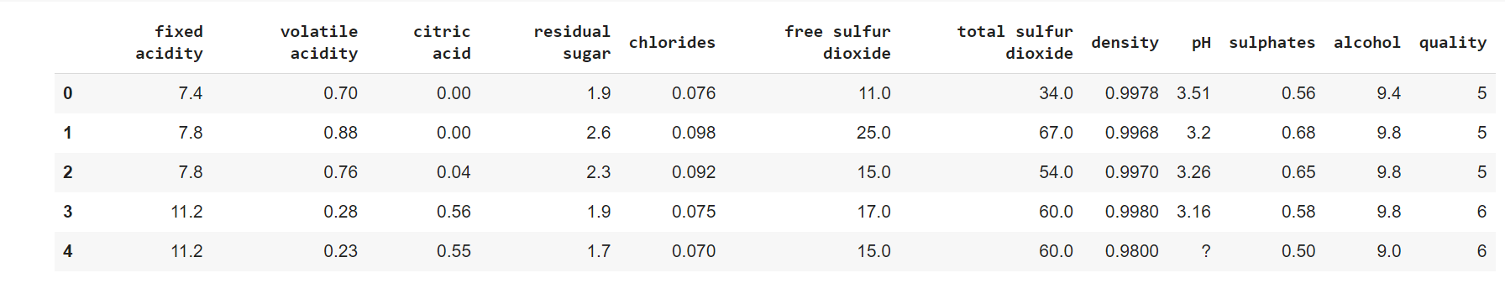
DATA SET
This dataset typically consists of 12 attributes.
There are 1603 instances.

Slide 5
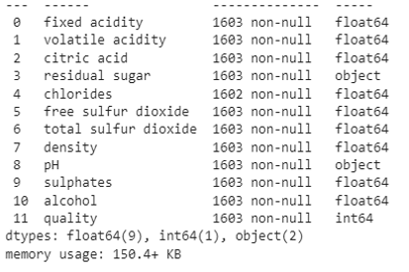
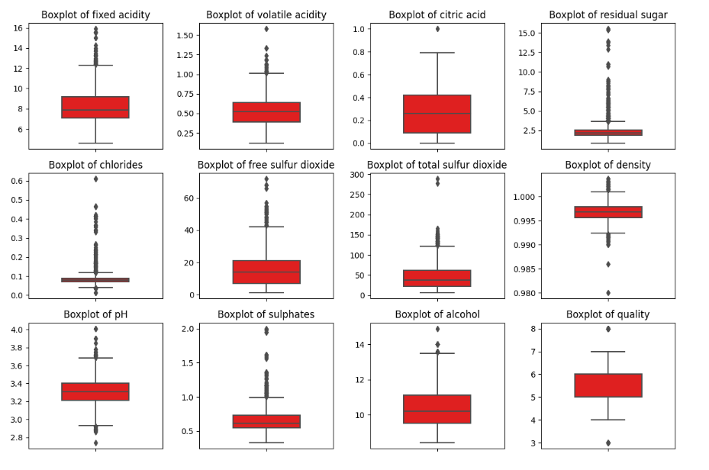
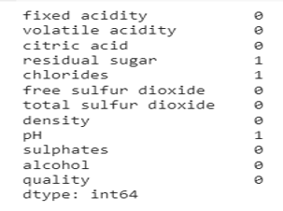
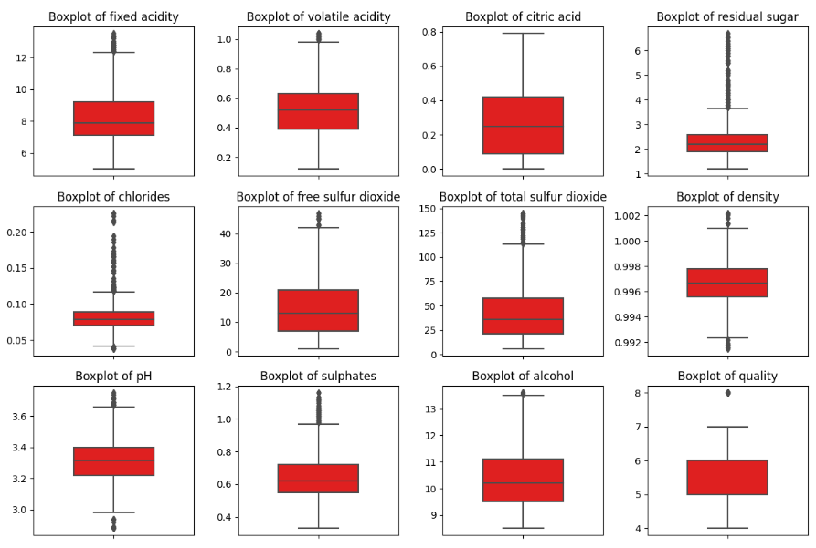
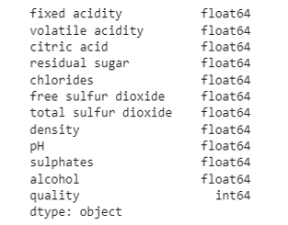
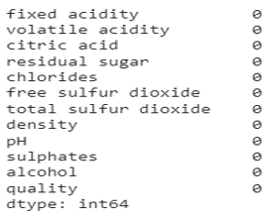
DATA CLEANING
Errors in Data Type
Outlier detection& rectification
Null value identification &rectification

Slide 6
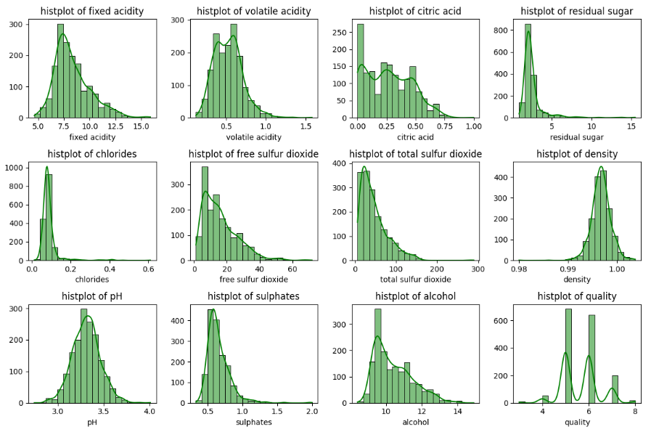
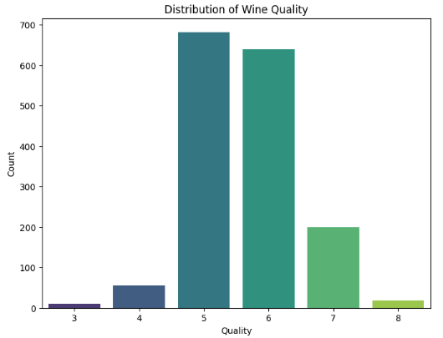
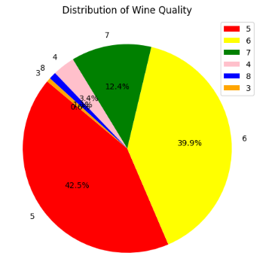
EXPLORATORY DATA ANALYSIS(EDA):
HISTOGRAM BAR GRAPH PIE

Slide 7
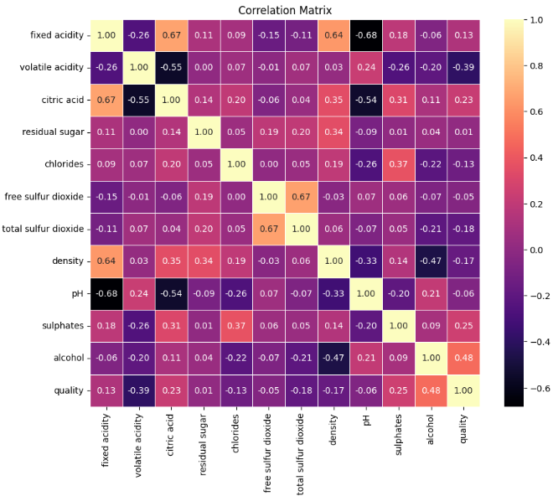
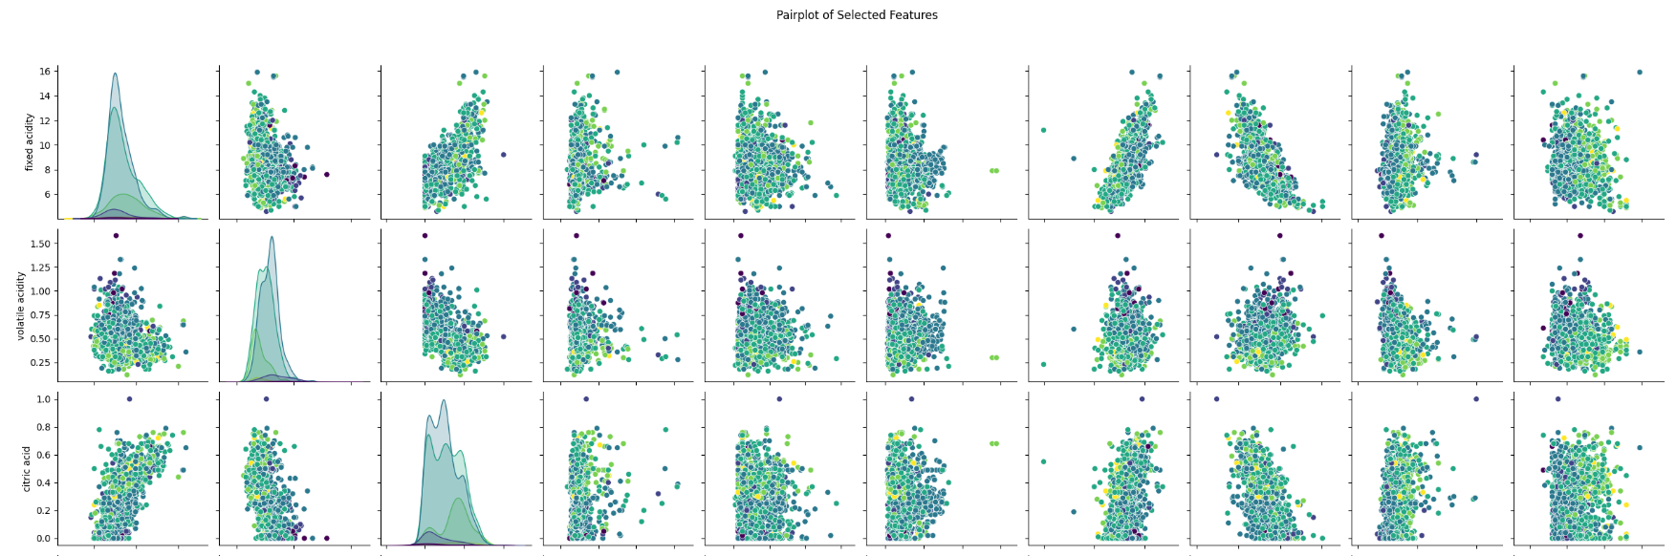
HEAT MAP PAIR PLOT

Slide 8
MACHINE LEARNING
-ALGORITHMS
LOGISTIC/LINEAR
SVM/SVC
DECISION TREE
RANDOM FOREST
NAÏVE BAYES
KNN
ADA BOOST
Xg BOOST
NEURAL NETWORK
REGRESSION
CLASSIFICATION

Slide 9
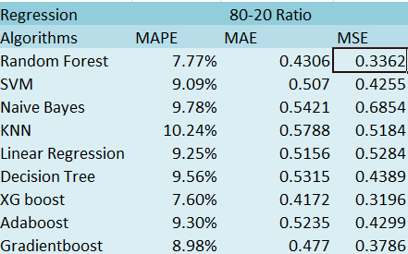
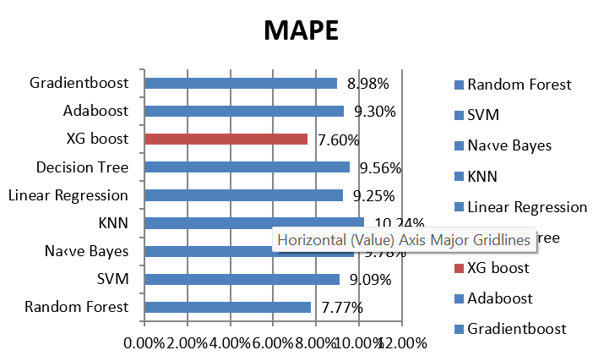
REGRESSION (80-20)

Slide 10
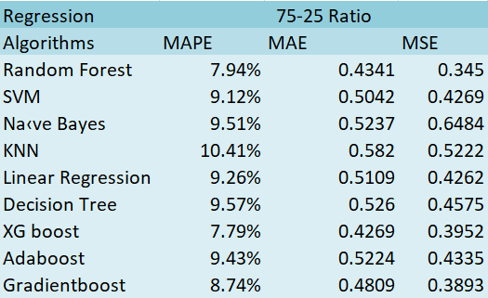
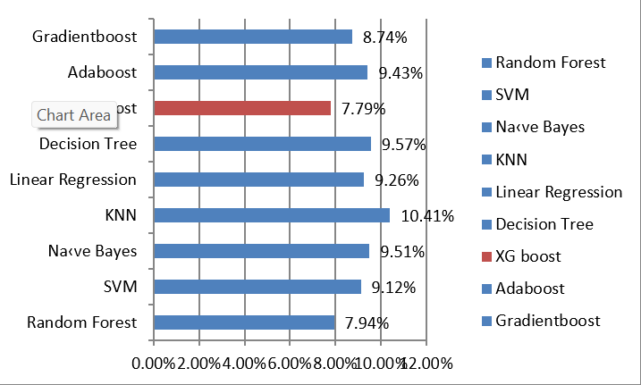
REGRESSION(75-25)

Slide 11
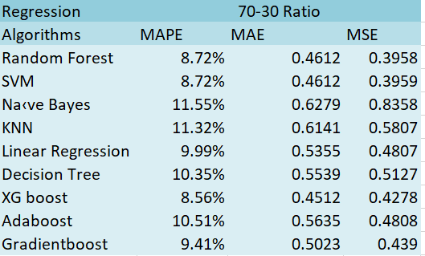
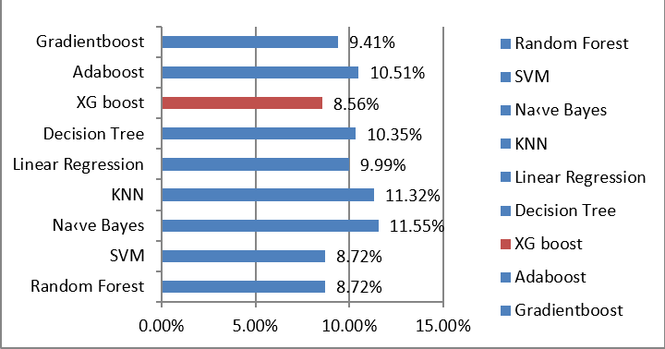
REGRESSION(70-30)

Slide 12
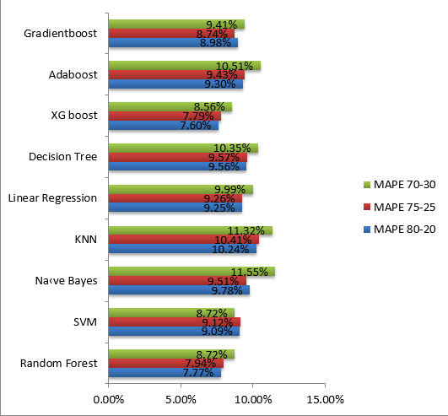
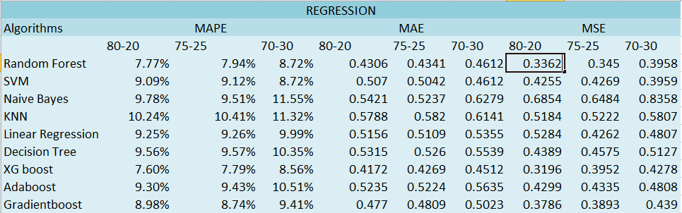
REGRESSION

Slide 13
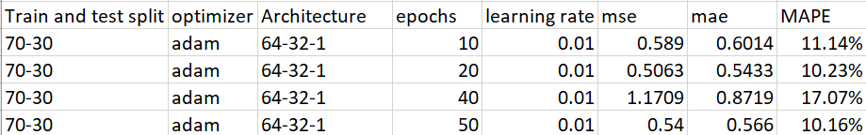
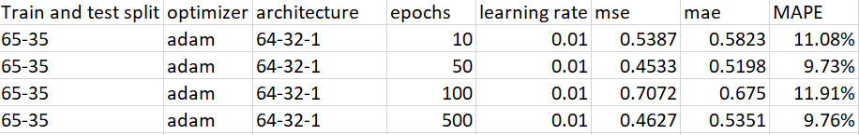
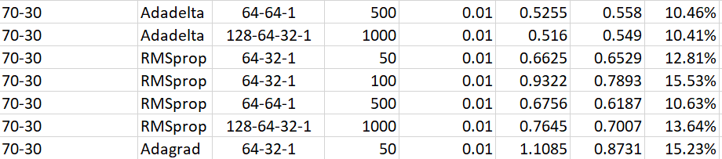
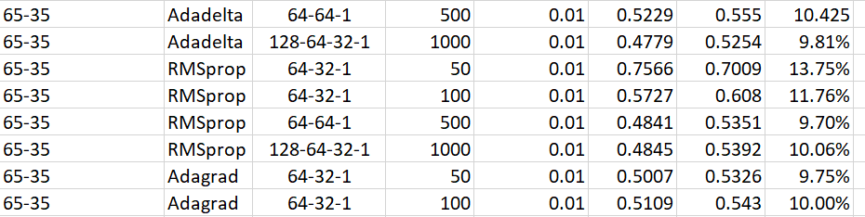
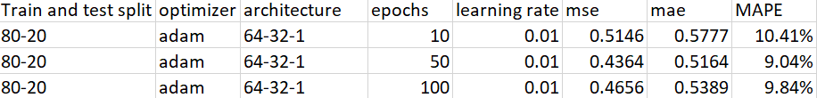
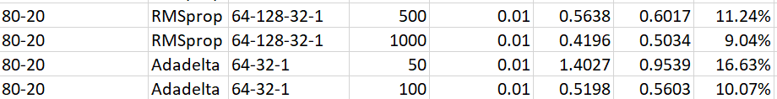
NEURAL NETWORK
The least MAPE

Slide 14
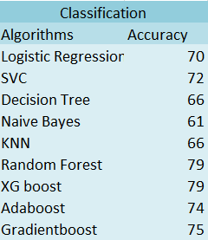
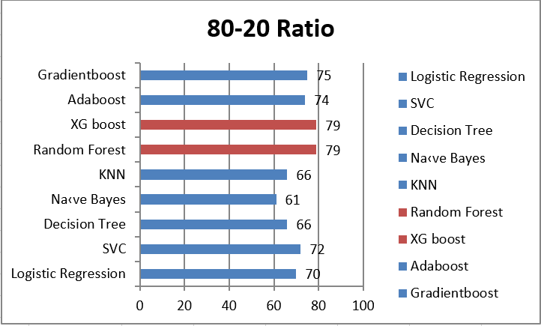
CLASSIFICATION(80-20)

Slide 15
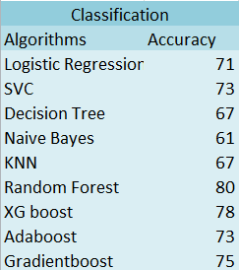
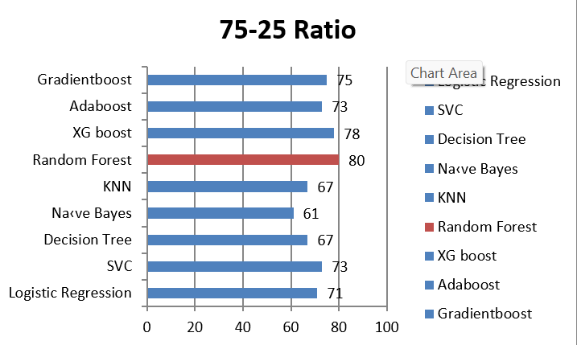
CLASSIFICATION(75-25)

Slide 16
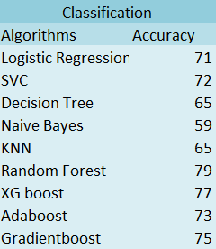
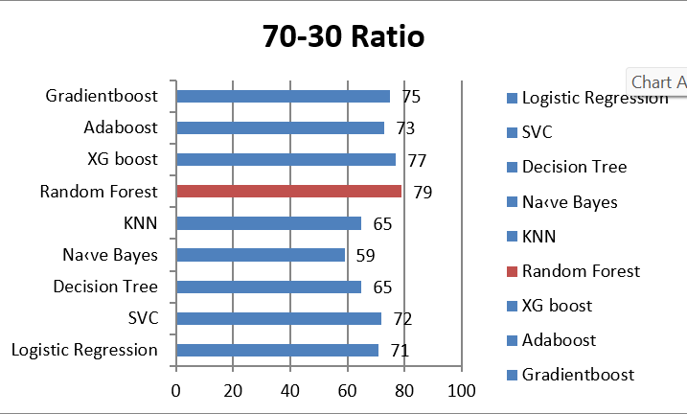
CLASSIFICATION(70-30)

Slide 17
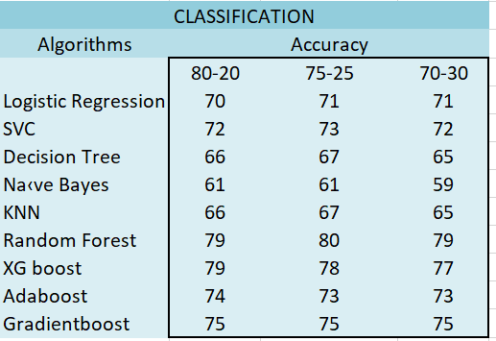
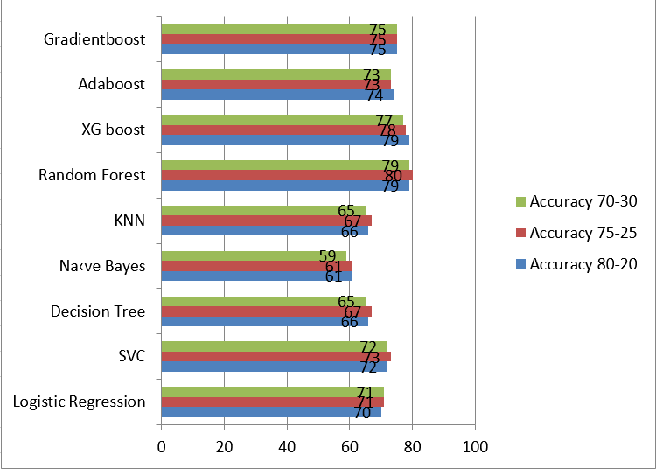
CLASSIFICATION

Slide 18
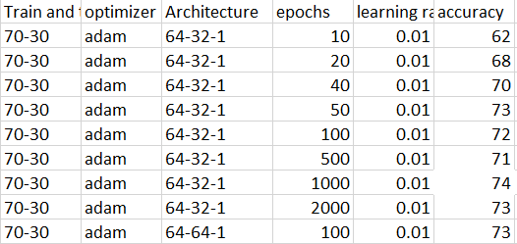
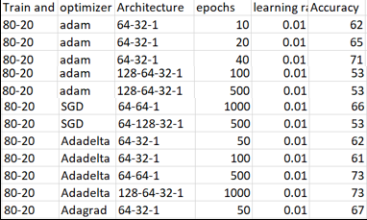
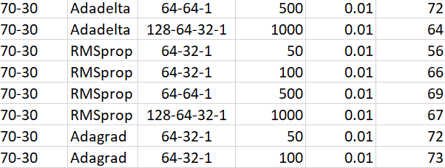
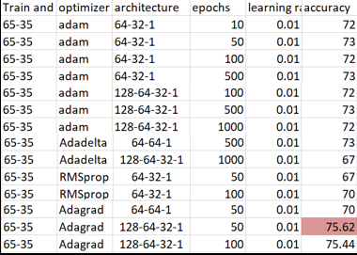
NEURALNETWORK
Highest Accuracy

Slide 19
CONCLUSION
In regression Xgboost is giving the least mape i.e 7.60 for the train and test split 80-20 ratio
In classification random forest is giving the highest accuracy i.e 80 for the train and test split 75-25 ratio
Compared to classification model, regression model is performing better

Slide 20
INSIGHTS
Wine Production Optimization: Winemakers can use machine learning models to predict the quality of wine based on chemical properties. This information can guide decisions during the production process, such as adjusting fermentation conditions, blending different batches, or optimizing grape selection.
Market Pricing: Wine quality prediction models can be used to estimate the market value of wines. Wineries, distributors, or retailers can leverage these models for pricing decisions based on predicted quality ratings.
Inventory Management: Wineries can optimize inventory levels based on predicted wine quality. This ensures that the right amount of each wine is produced, reducing waste and optimizing the use of resources.

Slide 21
APPENDIX
CLASSIFICATION: https://colab.research.google.com/drive/1zIVkjy8TKoKHWBUNdfvcKsZ0Q6Iwpavm?usp=sharing
REGRESSION: https://colab.research.google.com/drive/1zIVkjy8TKoKHWBUNdfvcKsZ0Q6Iwpavm?usp=sharing
DATA SET: ..\Downloads\winequality.csv

Slide 22
THANK YOU

